Slide 1
CS 419: Production Rendering Path Tracing
Eric Shaffer

Slide 2
A Brief History of Path Tracing
Path tracing ≈ recursive ray-tracing
Turner Whitted [1979]: perfect specular reflection and refraction
Cook et al [1984]: stochastic ray-tracing
glossy effects
motion blur
depth of field
Kajiya [1986]: rendering equation, full global illumination
Lafortune [1993]: Bidirectional path-tracing
Jensen [1995]: Photon mapping

Slide 3
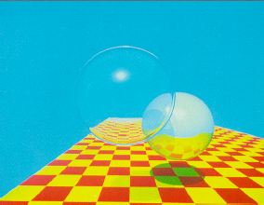
Whitted Ray-Tracing
1979, Turner Whitted
As an aside:
74 minutes at 640x480
By Moore’s Law we should now have 1024x1024 at 16 f.p.s.

Slide 4
Whitted Ray-Tracing
Recursive
Three types of rays are generated
shadow
reflection
refraction
Enables transparency and mirrors
Is not a good approximation for global illumination

Slide 5
Global Illumination
Whitted ray-tracing can’t discover certain light paths
The l1 to l2 path below wouldn’t be discovered

Slide 6
Path Tracing
Path Tracing: more completely approximates the rendering equation
Each ray is followed in a scene until:
It hits a light
Maximum recursion depth is reached
The ray leaves the scene

Slide 7
Path Tracing
At each hit point, a PDF is determines reflected ray direction
In pure Path Tracing radiance only comes from area lights
no point or directional lighting
A primary ray and its reflected rays are a ray path
Shoot multiple rays per pixel
The blue ray represents multiple primary rays! Each primary ray generates a single path.

Slide 8
Path Tracing
Bottom surface is Lambertian
Wall is specular

Slide 9
Path Tracing
Material type determines ray orientation
Pure Lambertian surfaces reflect rays in a random direction
Relying only on hitting lights leads to long convergence times
Few paths will hit lights in the recursion depth limit

Slide 10
A Monte Carlo Estimator for Path Tracing
To evaluate the radiance at each pixel:
We are generating n_{s} rays per pixel
The expression inside the summation computes radiance from first hit
But, of course, it’s recursive
Note: subscript i refers to incoming irradiance…not an index

Slide 11
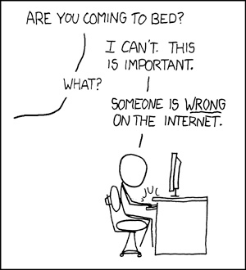
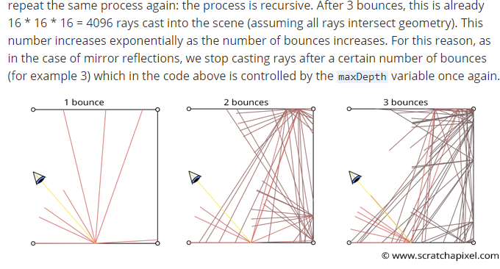
Things that are wrong on the internet
Path tracing does not branch…and yet

Slide 12
What is a good argument against branching?
Consider the relative contribution of rays cast at different depths

Slide 13
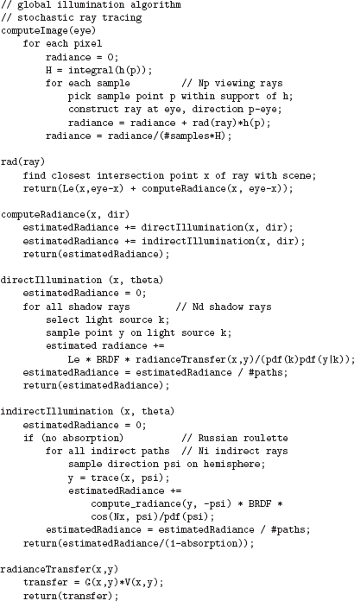
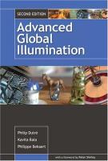
Path Tracer Example
How does this code deviate from pure path tracing?
Why does it do that?

Slide 14

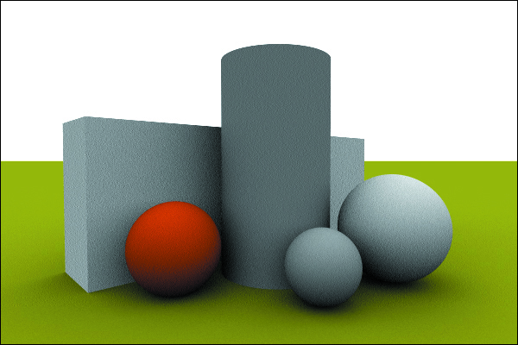
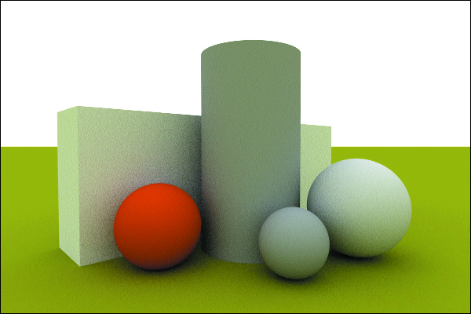
Path Tracing with an Environment Light
Zero bounces…one bounce….five bounces

Slide 15
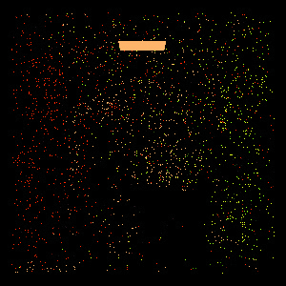
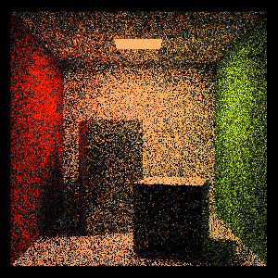
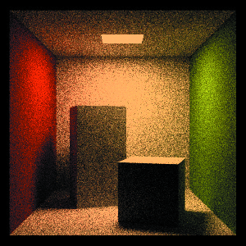
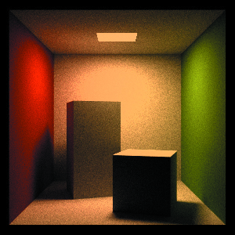
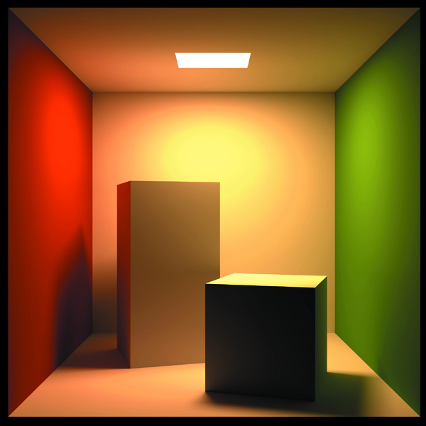
Path Tracing with an Area Light
1 sample per pixel 100 1024 10,000
100,000

Slide 16
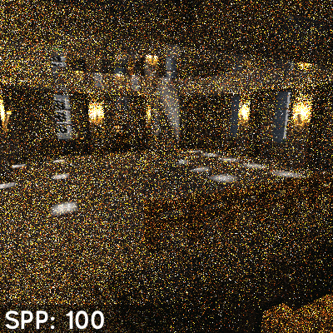
Convergence….

Slide 17
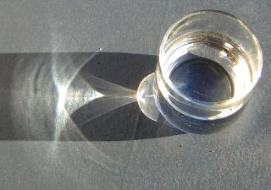
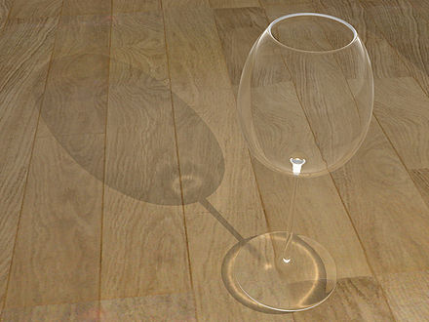
Caustics
Created by curved reflectors
Concentrate the reflected light
Caustics become thinner and sharper as light source becomes smaller or distant
Path Tracing has a hard time resolving caustics
Too few paths are generated that will result in adding the appropriate amount of radiance to the caustic
We don’t know how to adjust sampling to generate them like with specular highlights
Alternatives to Path Tracing are needed (e.g. Photon Mapping)

Slide 18
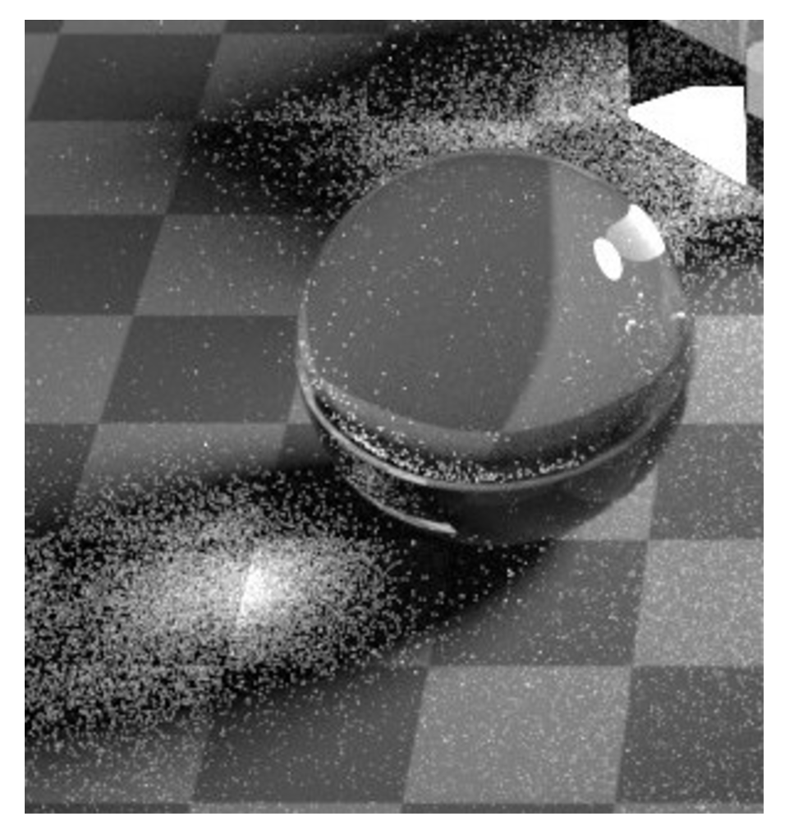
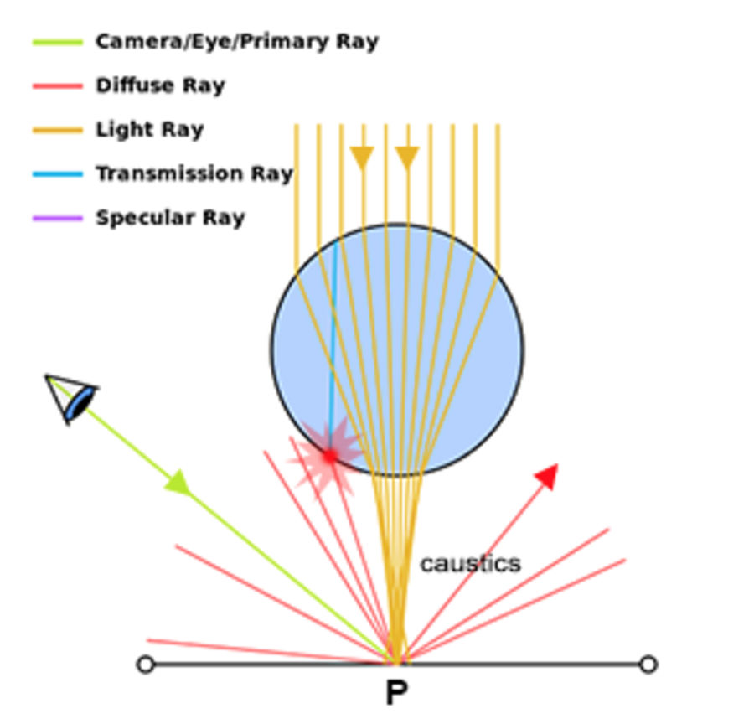
Caustics are Problematic (for Path Tracing)

Slide 19
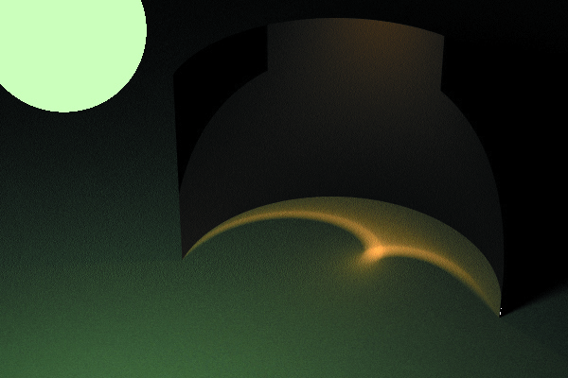
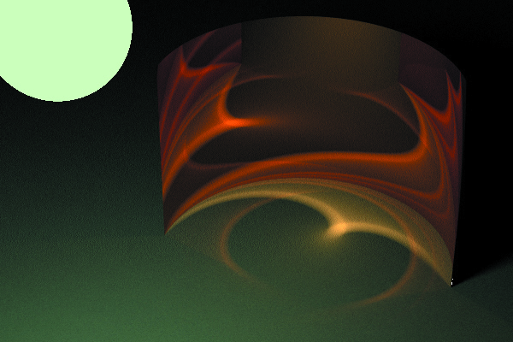
More Caustics
Recursion depth 2 versus 5

Slide 20
Regular Expressions for Light Paths
L = Light E = Eye D = Diffuse surface S = Specular surface
Monte-Carlo ray tracing handles all paths of light: L(D|S)*E
but not equally well
Has difficulty sampling LS*DS*E paths, e.g. a caustic

Slide 21
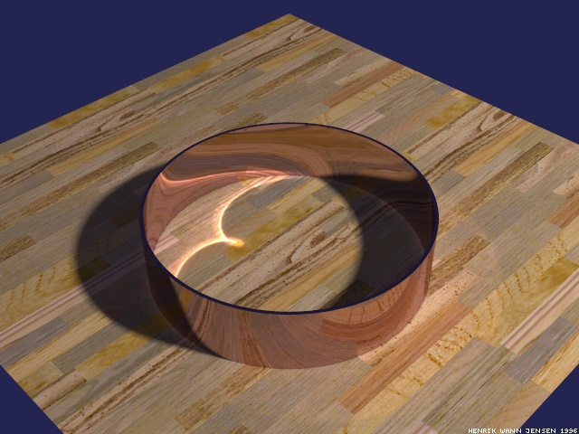
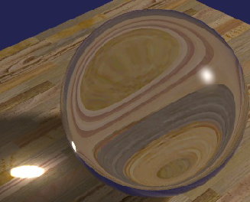
Rendering Caustics
Path tracing would need a very lucky first hit
Bidirectional ray tracing can find caustic, but reflection of caustic still needs lucky first hit during path tracing
Metropolis light transport can find a caustic path, but would need lucky perturbation to find its reflection
Photon Mapping solves the problem
Along with subsurface scattering

Slide 22
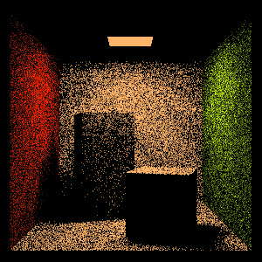
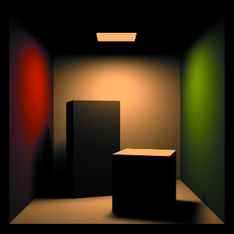
Path Tracing : Speedup through Light Sampling
Can employ a hybrid approach
Direct illumination computed by sampling lights
Indirect illumination computed by path tracing
Must take care not to render direct illumination twice
Sample direct illumination with a shadow ray
Indirect illumination as before
Hit on a light returns radiance if ray depth ≠ 1

Slide 23
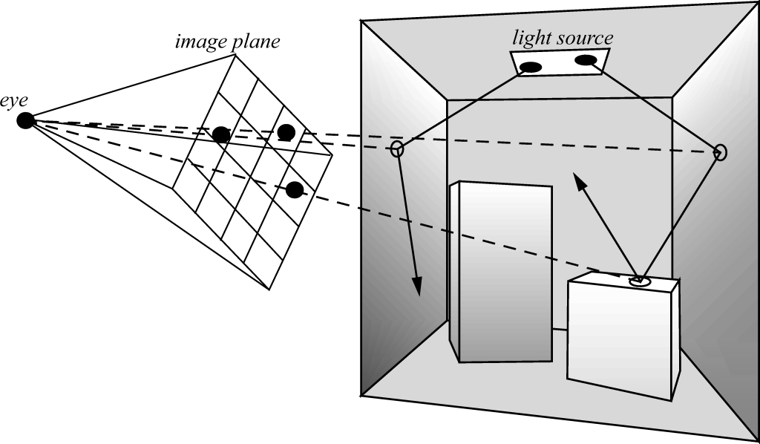
Bidirectional Path Tracing
Rays are traced from the lights and from the cameras
Endpoints and midpoints of paths are linked up to estimate radiance

Slide 24
Bidirectional Path Tracing
Lafortune & Willems, Compugraphics ’93, Veach & Guibas, EGRW 94
Send paths from light source, record path vertices
Send paths from eye, record path vertices
Use shadow rays to connect every vertex of eye path with every vertex in light path
Creates abundance of paths from light to eye
Need weighted average of these path results

Slide 25
Metropolis Light Transport
Based on Metropolis et al., Equation of State Calculations by Fast Compting Machines, J. Chemical Physics 21(6), 1953, pp. 1087-1092.
Adapted to bidirectional path tracing by Veach & Guibas, S97
Start with a connected path of light from the light source to the eye
Perturb the path of light to find new paths

Slide 26
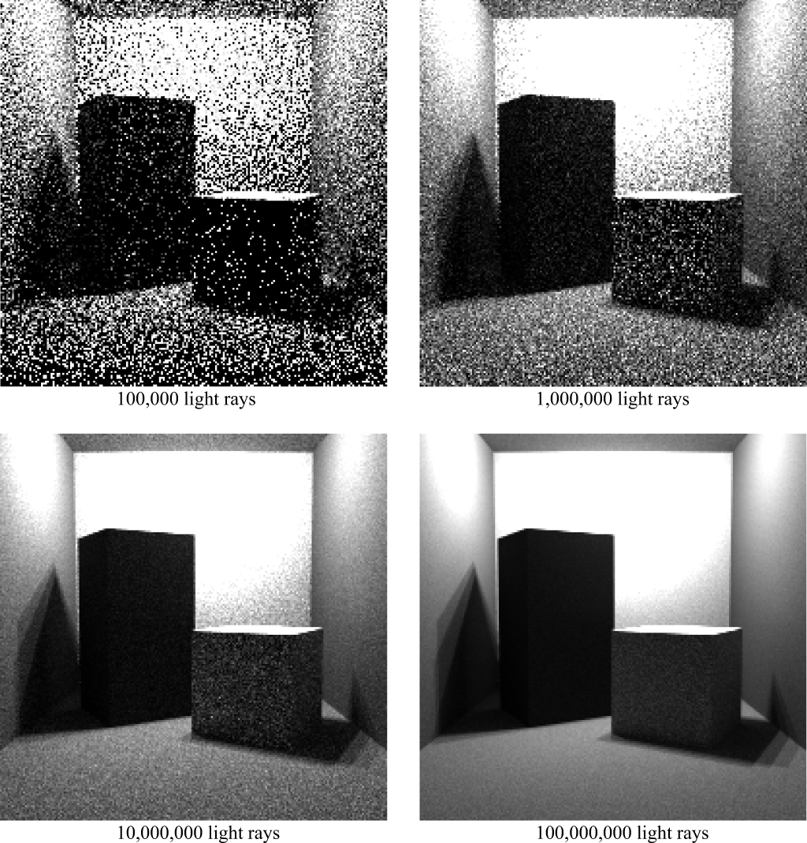
Aside: Pure Light Tracing Algorithm
For each pixel, we evaluate a measurement equation
Generate sample points and directions on lights
Importance of those samples to the pixel evaluated, leading to a radiance estimate

Slide 27
Russian Roulette
Recursive path generator needs a stopping condition
What is wrong with a simple depth limit?
When a ray hits a light
Radiance needs to be multiplied by what factors from previous intersection points?
Suppose we store this factor along a path…what cutoff criterion is suggested by that possibility?

Slide 28
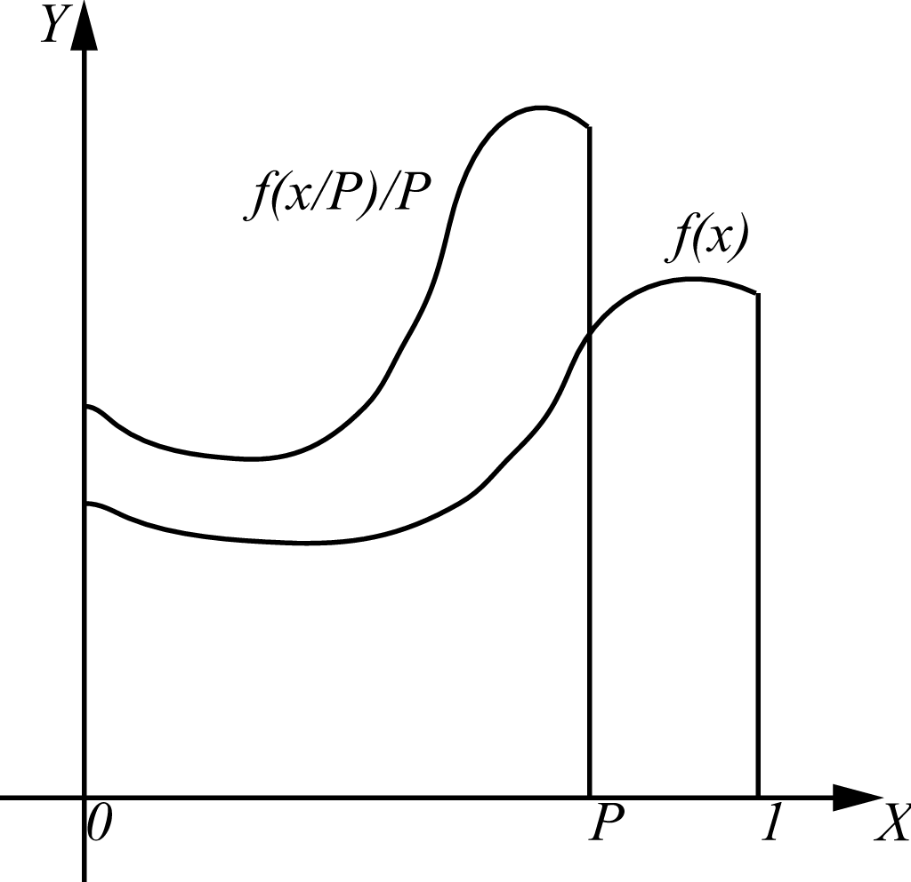
Russian Roulette
Imagine evaluating I as follows:
if f(x) is recursive, what is the probability the recursion stops at each evaluation point?

Slide 29
Russian Roulette and Bias
A biased algorithm changes the expected value of the Monte Carlo estimator so that it no longer matches the value of the integral.
Is RR biased? Look at the previous picture….
What is the benefit of a high absorption factor?
What is the drawback?
Imagine we set P to the reflectance of a surface. What surfaces absorb the path with greater frequency?

Slide 30
Pure Path Tracing: the Good
Path tracing can simulate most types of light transport
Exception: Caustics
Exception: Scattering (subsurface or participating media)
General surfaces – only requires ray intersections
Unbiased estimates
at any point, the expected value is correct
although variance might be high

Slide 31
Pure Path Tracing: the Bad
It treats every pixel independently, and every point on every surface independently
Good for specularities, which vary quickly over surfaces
Bad for diffuse illumination, which varies very slowly over surfaces (except at sharp shadow boundaries)
Effort is wasted getting good estimates for
Direct illumination, which is responsible for the most obvious illumination discontinuities (edges)
Diffuse illumination, which varies slowly over a surface

Slide 32
Path Re-Use
Consider a diffuse surface for which we want an outgoing radiance estimate
Typically, we would cast more rays to get it, but what if we already know what happened at a nearby spot?

Slide 33
Diffuse Dependency
Diffuse reflectance depends only on irradiance at the surface point
Amount of light incoming from a specific direction is sort of irrelevant
This tends to vary slowly over a surface
Directional light gives constant irradiance over a planar surface
Point light varies only with the cosine of the angle – slowly

Slide 34
Basic Idea
Store information about previous paths
When the irradiance at a point is required
Construct irradiance estimates from the stored data
The sub-problems are:
How do you get the samples in the first place?
How to you store them?
How do you construct the estimate?

Slide 35
Irradiance Caching
Start with a basic path tracing algorithm, but …
Maintain a spatial data structure storing irradiance arriving at points
If you hit a diffuse surface,
Build an estimate of irradiance at that point using stored date
If the estimate is good, use it
If not, use path tracing to estimate the irradiance and store it
Some questions:
How do we store the samples?
How do we decide whether to compute a new value?

Slide 36
Storing Samples
It doesn’t much matter how you store the samples
Data structure must support
insertion of new samples, and
search for nearby samples, indexed on position
The RADIANCE system has Irradiance Caching, and it uses Octrees
What to store:
Irradiance
The location
The normal at that location

Slide 37
Is an Estimate Good?
The quality of an estimate is based on geometric considerations
Examine:
Surface curvature between the required point and the existing data
diffuse illumination changes with curvature
Brightness of and the distance to other surfaces
Influences how fast incoming illumination can change
If existing values are used, weight contribution by quality

Slide 38
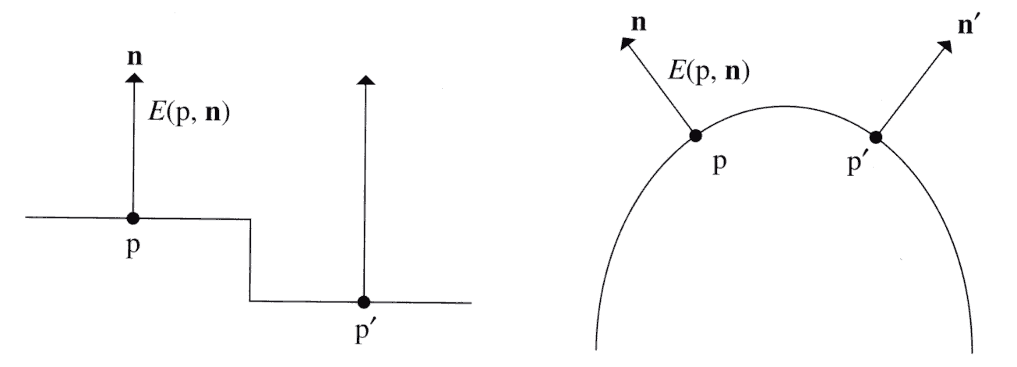
Geometric Factors
Small distance, but maybe big change in irradiance
Points and normals should be close
Corners lead to fast changes in irradiance

Slide 39
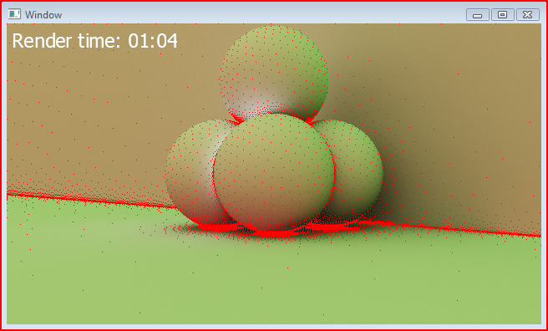
Locations of Estimates

Slide 40
Implementation Notes
In a full system, choices must be made as to what constitutes a diffuse surface
PBRT assumes anything that isn’t specular
Error goes up as reflectance varies further from diffuse
Must account for transmission and reflection
Separate irradiance estimates for both sides of a surface

Slide 41
Motion Blur
One implementation (courtesy of Peter Shirley)
Have a time associated with a ray
Generate rays with a time randomly chosen in [start, end]
Objects have time parameter as well
Object can return its position at a given time

Slide 42
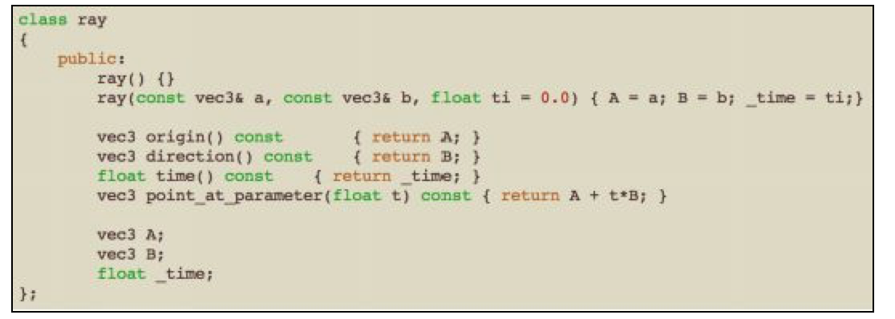
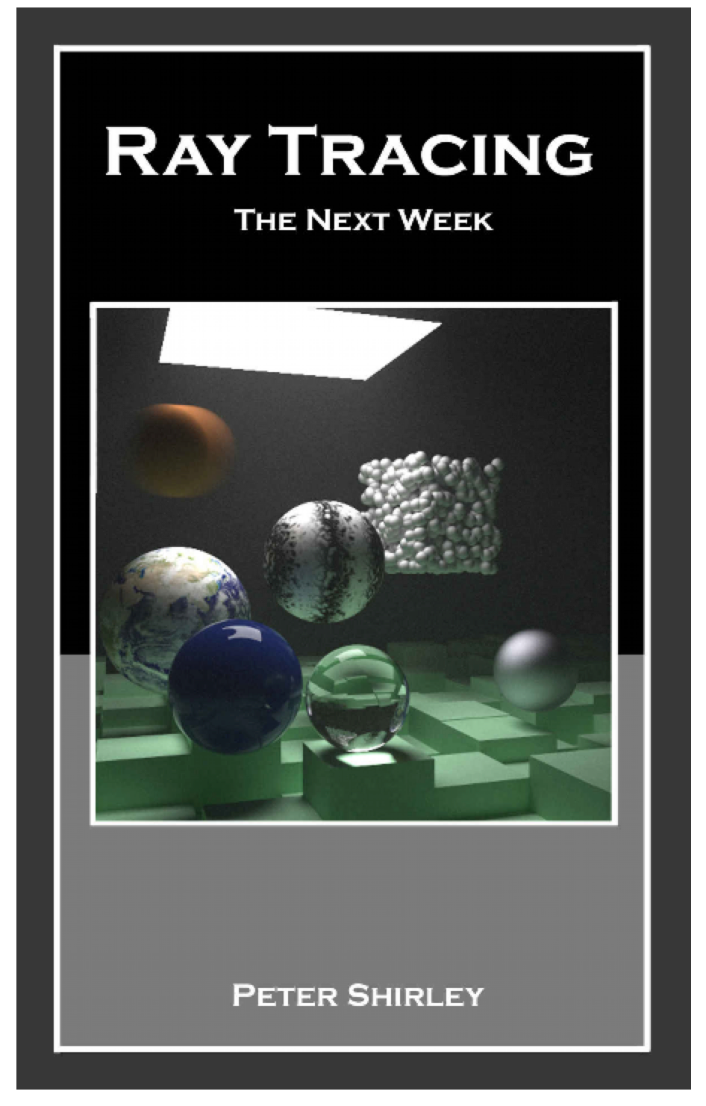
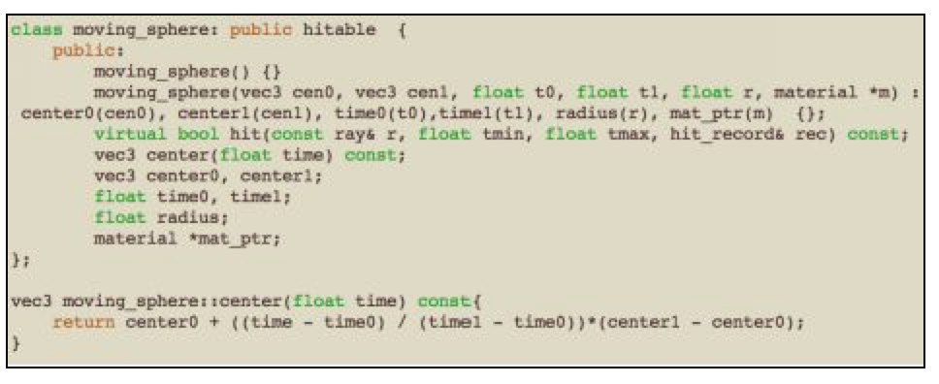
Motion Blur
From:
Ray Tracing: The Next Week by Peter Shirley

Slide 43
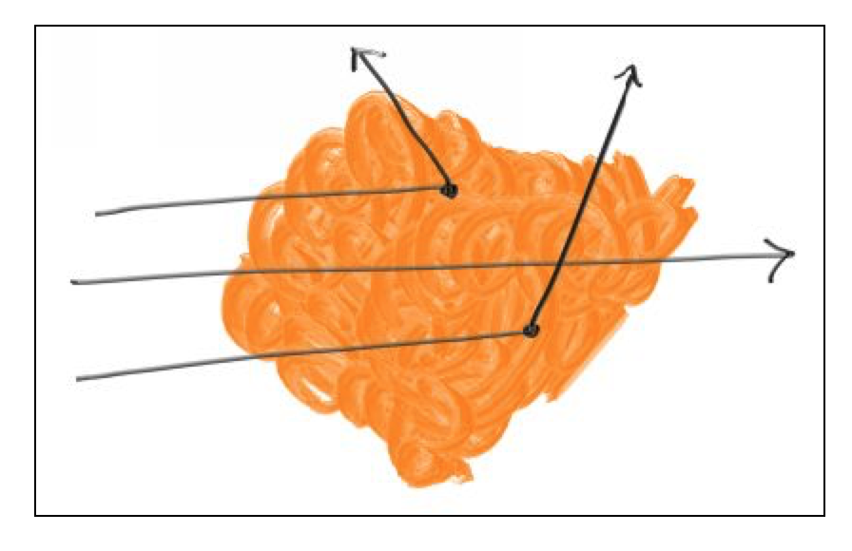
Participating Media (Volumes)
Warning: There are better ways to implement fog/smoke
They are also more complicated and computationally intensive
We can cheat by using a model of a solid object
Make it probabilistic…
Ray passes through object with some probability 1-P
P is the probability the ray scatters
We’ll model a constant density volume
P = C*dL
C is proportional to the optical density of the volume
dL is a small distance

Slide 44
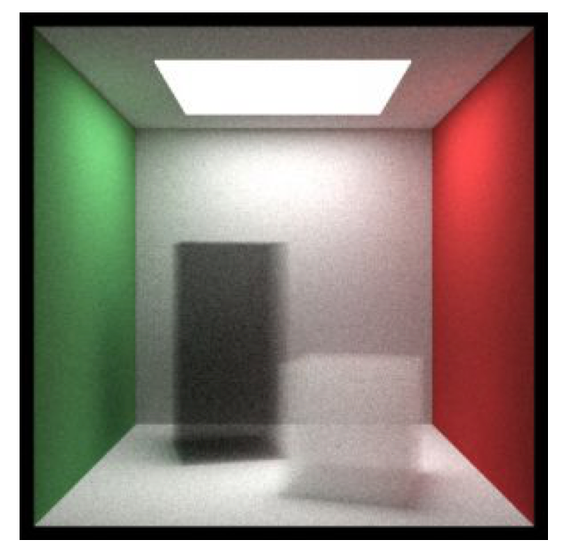
So….
Define a density
Determine the distance the ray travels through the volume
Flip a biased coin to see if the ray escapes or not
What effect will this not generate?

Slide 45
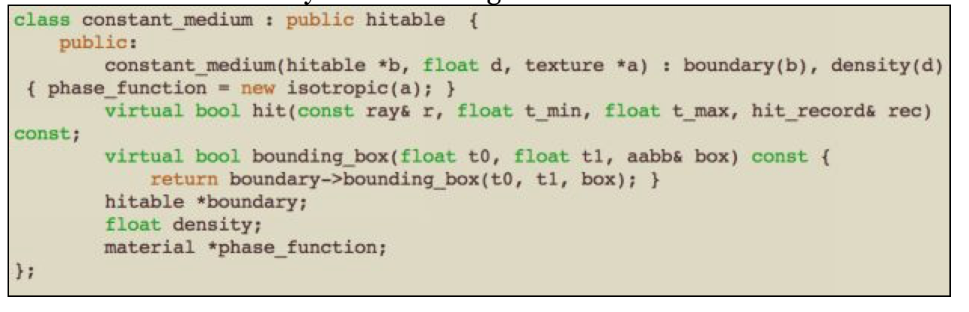
Code….

Slide 46
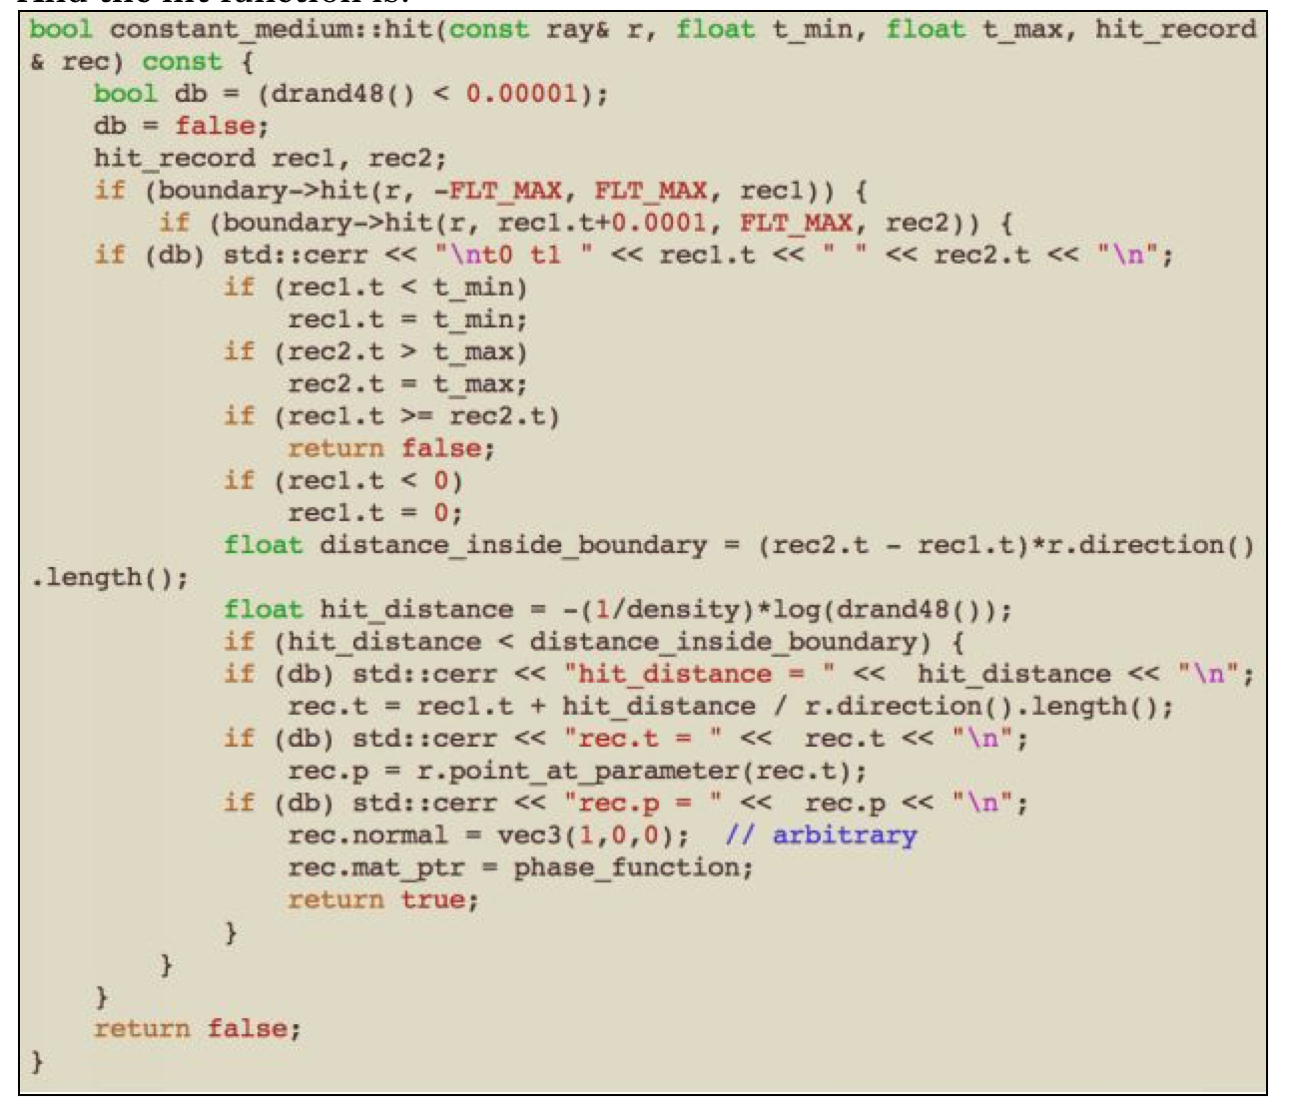
Code….

